Slide 1
Handwritten Text to Digital Text Conversion
 |  | Upender Reddy Chitla | 700740052
 |  | Haripriya Eddala | 700746136
 |  | Sahithi Gunda | 700745560

Slide 2
ROLES AND RESPONSIBILITES
Upender Reddy Chitla worked on random forest in order to work on various algorithms, convolution neural network.
Haripriya Eddala worked on Recurrent Neural Network to get better accuracy on different datasets, and decision tree.
Sahithi Gunda worked on the support vector machine to get better accuracy, multinomial logistic regression.

Slide 3
INTRODUCTION
Handwritten Text Recognition (HTR), sometimes referred to as Handwriting Recognition (HWR), is the process by which a computer recognizes and understands handwritten text pictures.
The computer can be instructed to forecast and transform handwritten text into computerized or digital text from a variety of sources, including notebooks, documents, forms, photos, and other devices.

Slide 4
MOTIVATION
A large portion of this transition involves detecting transcripts from information inspection photos and turning them into high-level designs using manually written text recognition (HTR) or handwriting recognition (HWR). Notebooks, documents, forms, and photos are just a few of the devices that provide the input.
There are two kinds of recognition:
1. Online Recognition
2. Recognition Offline

Slide 5
OBJECTIVE
• Focused on an AI methodology with recognizable components.
• Recurrent Neural Networks are used to handle numerous text image windows that overlap.

Slide 6
RELATED WORK
The image processing, feature extraction, and classification methods employed in the development of each OCR system cause them to differ from one another.
For the purpose of reading alphanumeric characters, it is utilized as an input device for papers that have already been printed.
It is impossible for the current technologies to distinguish between a word and noise. A little dot that is actually noise is also recognized as a word.
Turkish OCR on mobile and scanned document images | Kurtulus Karasu, Muhammet Bastan (2015)
A proposed approach for character recognition using Document Analysis with OCR | Harneet Singh, Anmol Sachan (2018)
Classification of Documents Extracted from Images with Optical Character Recognition Methods | Omer Aydin (2021)

Slide 7
PROBLEM STATEMENT
Understand and be conversant with ideas such as support vector machines and decision trees in order to apply algorithms to real-world issues. Additional observations are made based on the reviewed studies.
Worked on different algorithms, to get better accuracy.
Comparing the accuracies and plotting graphically.

Slide 8
PROPOSED SOLUTION
A library of prototype images is compared with the character image using the template matching method.
The recognition of handwritten text heavily relies on neural networks.
The performance of the model can be improved by using deep learning algorithms.

Slide 9
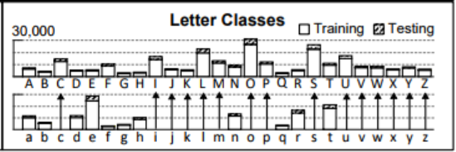
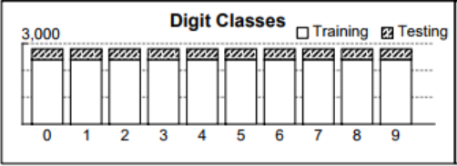
VARIOUS MODELS USED FOR THE PURPOSE
Multiclass Logistic Regression
Decision Tree
Random Forest
Neural Networks
Convolution Neural Networks
Recurrent Neural Networks
Dataset used for all the models is Extra Keras EMNIST Dataset.
Train | 112800
Test | 18800
Total | 131600
Classes | 47

Slide 10
BLOCK DIAGRAM
Raw Data
Data Processing
Processed Data
Train Model (Train Accuracy)
Test Accuracy
Model Tuning
Accuracy Satisfied?
Deploy Model

Slide 11
RESULTS
Accuracy of the various models used is tabulated below:
Model | Accuracy (%)
Multiclass / Multinomial Logistic Regression | 69.42
Decision Tree | 58.90
Random Forest | 80.92
Neural Network | Train: 91.07, Test: 83.36
Convolution Neural Network | Train: 93.51, Test: 85.07
Recurrent Neural Network | Train: 93.15, Test: 86.81

Slide 12
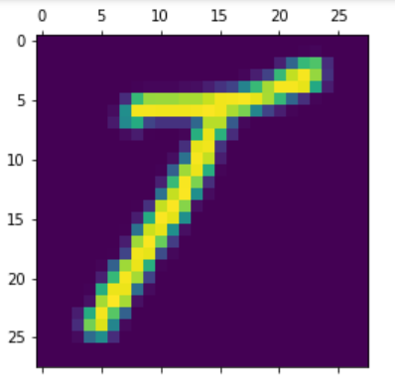
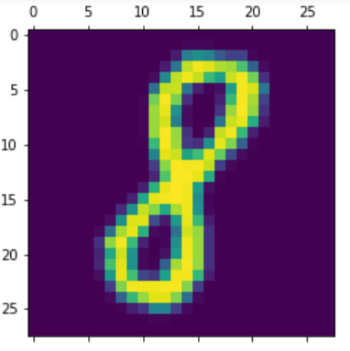
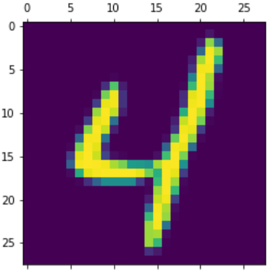
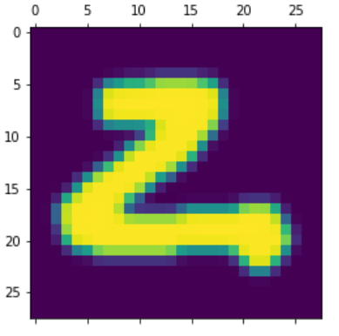
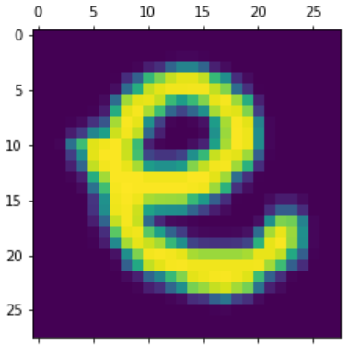
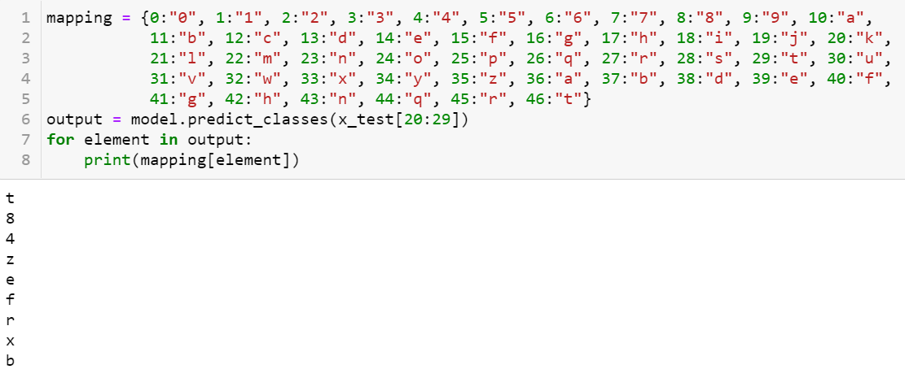

Slide 13
CONCLUSION AND FUTURE SCOPE
A suggested method for converting handwritten text to digital text has been developed and evaluated. There has been a comparison with related works shown.Various models have been trained for this purpose with various types of input datasets.
A digital text conversion technique for handwritten text has been created and tested. A comparison with related works has been displayed..
By breaking apart words and removing the letters, it can also be used to recognize and transform sentences.

Slide 14
REFERENCES
https://ieeexplore.ieee.org/document/7130278
https://www.academia.edu/49062168/Classification_of_Documents_Extracted_from_Images_with_Optical_Character_Recognition_Methods
https://ieeexplore.ieee.org/document/8663011
https://www.academia.edu/49062168/Classification_of_Documents_Extracted_from_Images_with_Optical_Character_Recognition_Methods
https://ieeexplore.ieee.org/document/9297418

Slide 15
THANK YOU

